Slide 1
Unit n° 1
1.1 & 1.2
TARGET KET BOOK
1EROS MEDIOS 2020

Slide 2
UNIT 1.1
Introduccions
Present Simple
Adverbs of frequency
Vocabulary: countries, nationalities, languages, numbers, alphabet/school subjects, days and times
Introducing yourself
Use:
We use I’m to give personal information.
Example: Hi, I’m Sara. I’m from Canada
Introductions:
Use:
We use Nice to meet you when we meet someone for the first time.
Example: Hello, Sara. Nice to meet you.
We use This is… to introduce someone.
Example: This is my brother, James

Slide 3
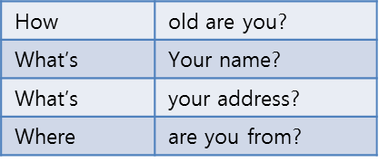
Asking about someone else
Use:
We use questions with how, what and where to ask about someone when we meet them.
Example: Hi, I’m Tim. What’s your name?
The question How are you? Asks about someone health.
Example: Hi, How are you?
I’m fine, thanks.
Spelling
Use:
We use capital letters at the start of names and countries.
Example: James is from Canada.
Yuyiko is from Japan.
We use double to give spellings.
Example: Will is spelled W - I – double L.
My surname is Moss. That’s M- O double S.

Slide 4
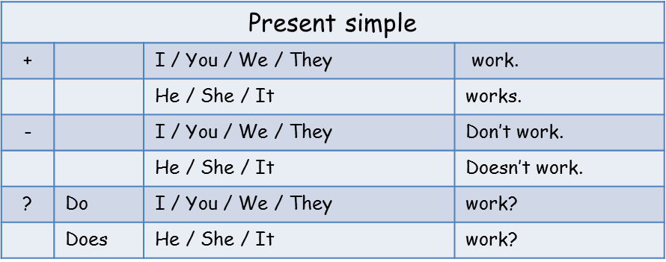
We use the present simple to talk about things we do every day, and talk about likes and dislikes.
Example: -I go to a theatre school.
-I don’t have English every day.
-What do you have on Monday?
-She doesn’t like singing.

Slide 5
Remember that in positive sentences, we add –s –es or ies in he, she and it forms.
Example: - He plays football every day.
- She goes to a theatre school.
- She studies singing.
1. In general, the third person singular is formed by adding an s to the base verb.
work He works
2. Verbs ending in ss,x,ch,sh,o add “es” to the third person singular. (he, she, it)
dress She dresses
fix He fixes
watch She watches T.V.
wash She washes
go It goes !
3. Verbs ending in consonant + y, changes the y to i and add “es”
Consonant + y  i + es: cry – cries, fly – flies, terrify - terrifies

Slide 6
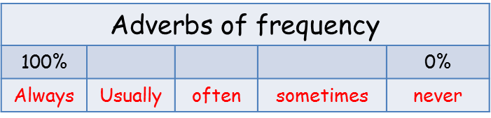
USE: We use frequency adverbs to say how often we do something.
Example: - He always plays football in the afternoon.
- I never enjoy Maths .
In negative sentences, adverbs of frequency come between don’t or doesn’t and the verb.
Example: - I don’t alwyas have Geography on Monday.
- He doesn’t usally play matches in the morning.

Slide 7
A. Countries
B. Languages
C. Nationalities
Argentina:
Australia:
Brazil:
Canada:
China:
Greece:
Ireland:
Mexico:
Poland:
Spain:
Thailand:
Chinese:
English:
French:
Greek:
Italian:
Polish:
Portuguese:
Spanish:
Thai:
Argentinian:
Australian:
Brazilian:
Canadian:
Chinese:
Greek:
Irish:
Mexican:
Polish:
Spanish:
Thai:

Slide 8
D. Numbers
E. Personal
Details
F. Days
G. Times
One:
Two:
Three:
Four:
Five:
Six:
Seven:
Eight:
Nine:
Ten:
Eleven:
Twelve:
Thirteen:
Fourteen:
Fifteen:
Sixteen
Seventeen:
Eighteen:
Nineteen:
Twenty:
30. Thirty:
40. Fourty:
50. Fifty:
60. Sixty:
70. Seventy:
80. Eighty:
90. Ninety:
100.A hundred:
Half past:
A quarter past:
(Ame) a quarter after:
A quarter to
(Ame) a quarter of:
birthday:
Monday:
Tuesday:
Wednesday:
Thursday:
Friday:
Saturday:
Sunday:
weekday:
week
weekend:
Address:
Age:
Country:
Favourite:
First name:
Phone number:
street:
Surname:
Spain:

Slide 9
A. School subjects
B. School words
Art:
Computer studies:
Design:
Drama:
English:
French:
Geography:
History:
Maths:
Science:
Sports:
break:
course:
homework:
lesson:
student:
subject:
timetable:

Slide 10

STUDENT’S BOOK AUDIO FOR UNIT 1.1
(VER EN LIBRO O GUIA EXTRA)
ACT N° 5 LISTEN AND REPEAT THE ALPHABET, PAGE 7
ACT N° 6 LISTEN AND WRITE THE LETTER YOU HEAR.
ACT N° 7 LISTEN AND REPEAT THE NUMBERS.
ACT N° 8 LISTEN AND WRITE THE NUMBERS.
ACT N° 9 LISTEN PART 4

Slide 11
STUDENT’S BOOK AUDIO FOR UNIT 1.2
(VER EN LIBRO O GUIA EXTRA)
ACT N° 4 LISTENING PART 2
PAGE 8 –STUDENT’S BOOK.

